Slide 1

Telecommunications customer churn
Presented by: Guided by:
Rupal Meshram Shubham Shelke Neha Gupta ma’am
Pooja Phadake Prajakta Sapkal
Manasi Bhabad Harshvardhan
Dhanashri Bhabad Malgi

Slide 2
Introduction
Customer churn is when a customer chooses to stop using products or services of a company. But with each customer who churn, there are usually early indicators or metrics that can have been uncovered with churn analysis.
Customer churn is a big problem for telecommunications companies. Indeed, their annual churn rates are usually higher than 10%.
To reduce customer churn, telecom companies need to predict which customers are at high risk of churn.

Slide 3
Objectives:
What's the percent of Churn Customers?
Is there any preference in Churn Customers based on the type of service provided?
Which features or services are most profitable?
Develop strategies to keep as many clients as possible.

Slide 4
STEP 1: Load libraries and data
import pandas as pd
import numpy as np
import matplotlib.pyplot as plt
import seaborn as sns
import statsmodels.api as sm
from scipy.stats import norm
from scipy import stats
from sklearn.tree import DecisionTreeClassifier
from sklearn.ensemble import RandomForestClassifier
from sklearn.linear_model import LogisticRegression

Slide 5
STEP 2: Understanding the data
account_length | voice_mail_plan | voice_mail_messages | day_mins | evening_mins | night_mins | international_mins | customer_service_calls | international_plan | day_calls | day_charge | evening_calls | evening_charge | night_calls | night_charge | international_calls | international_charge | total_charge | churn
0 | 128 | 1 | 25 | 265.1 | 197.4 | 244.7 | 10.0 | 1 | 0 | 110 | 45.07 | 99 | 16.78 | 91 | 11.01 | 3 | 2.70 | 75.56 | 0
1 | 107 | 1 | 26 | 161.6 | 195.5 | 254.4 | 13.7 | 1 | 0 | 123 | 27.47 | 103 | 16.62 | 103 | 11.45 | 3 | 3.70 | 59.24 | 0
2 | 137 | 0 | 0 | 243.4 | 121.2 | 162.6 | 12.2 | 0 | 0 | 114 | 41.38 | 110 | 10.30 | 104 | 7.32 | 5 | 3.29 | 62.29 | 0
3 | 84 | 0 | 0 | 299.4 | 61.9 | 196.9 | 6.6 | 2 | 1 | 71 | 50.90 | 88 | 5.26 | 89 | 8.86 | 7 | 1.78 | 66.80 | 0
4 | 75 | 0 | 0 | 166.7 | 148.3 | 186.9 | 10.1 | 3 | 1 | 113 | 28.34 | 122 | 12.61 | 121 | 8.41 | 3 | 2.73 | 52.09 | 0

Slide 6
The dataset includes information about:
Customers who left – the column is called churn.
Services that each customer has signed up for-voice mail plan, international plan, voice mail messages, customer service calls.
Total minutes customer spends on different times of days-
Charges which customers have to pay.

Slide 7
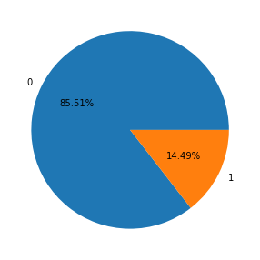
STEP3: Data Visualization
85.51% of the data is not churning and the remaining 14.49% is churning.

Slide 8
Data visualization is useful for data cleaning, exploring data, detecting outliers and unusual groups, identifying trends and clusters etc. There are different types of data visualization plots to spot the outliers.
Box plot
Histogram, etc

Slide 9
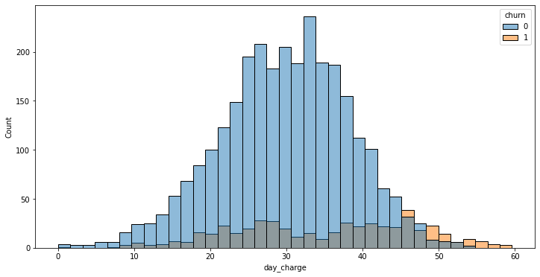
Outliers are often easy to spot in histograms. For example, the point on the far left in the above figure is an outlier. A convenient definition of an outlier is a point which falls more than 1.5 times the interquartile range above the third quartile or below the first quartile.
Churn rate is high in between 522-55 in day charge.

Slide 10
Detection and removal of outliers
Outlier is an observation that is numerically distant from the rest of the data or in a simple word it is the value which is out of the range.
Outlier can be of two types: Univariate and Multivariate.
Different outlier detection technique:
Z-score method, I.Q.R method, Percentile Capping

Slide 11
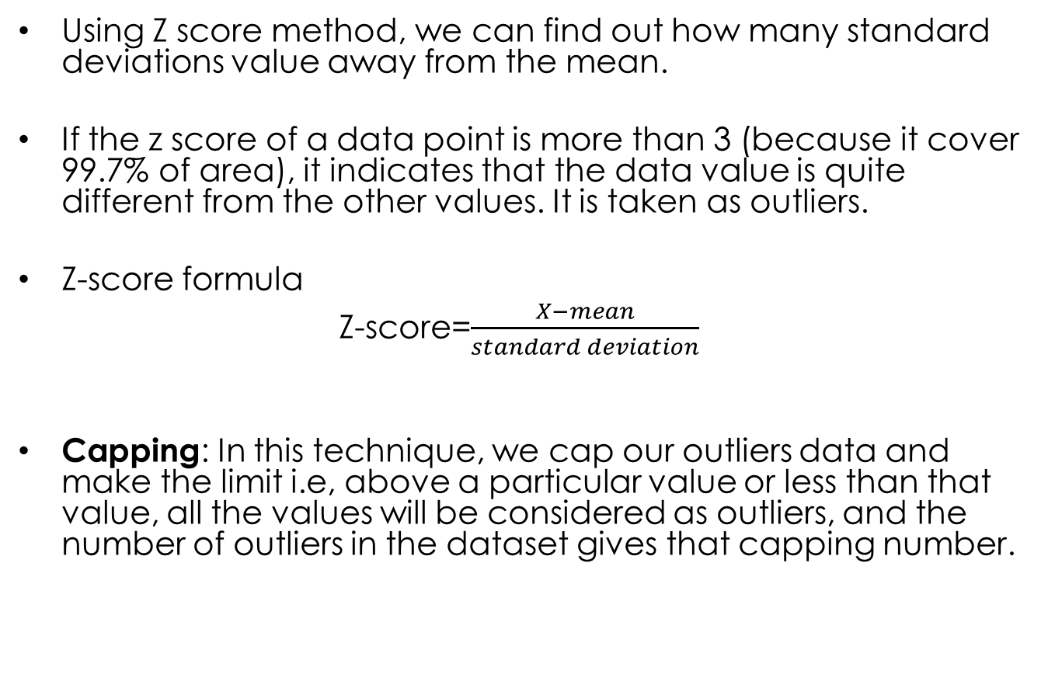
Using Z score method, we can find out how many standard deviations value away from the mean.
If the z score of a data point is more than 3 (because it cover 99.7% of area), it indicates that the data value is quite different from the other values. It is taken as outliers.
Z-score formula
Z-score=$\frac{X−mean}{standard deviation}$
Capping: In this technique, we cap our outliers data and make the limit i.e, above a particular value or less than that value, all the values will be considered as outliers, and the number of outliers in the dataset gives that capping number.

Slide 12
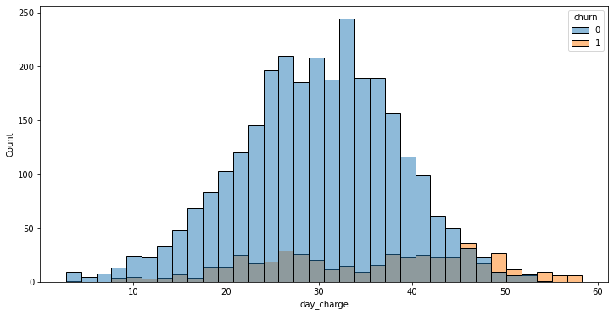
After capping we get this type of histogram plot.

Slide 13
STEP4: Feature Engineering
Account length not play important role in churn
In the International plan those customers who have this plan are more likely to churn .
In international calls data shows that the churn rate of which customers is high, those who take the international plan so it means that in international call charges are high also there is a call drop.

Slide 14
STEP5:Model Building
Logistic Regression
Accuracy:85.90%
Decision Trees for Classification
Accuracy:97.59%
Random Forest Classification
Accuracy:97.60%
XGBoost Classifier
Accuracy:97.91%

Slide 15
STEP6: Save the model and deployment
Before we deploy our model, we need to lad our model in our pickle format from where streamlit will run our main python file.
Saving the .py and .pkl file in our path so that we can run them locally.
We saved all or files like python main file, requirnments.txt, pickle model in Github repository.
We copied our github link for streamlit app where its going to be used.

Slide 16
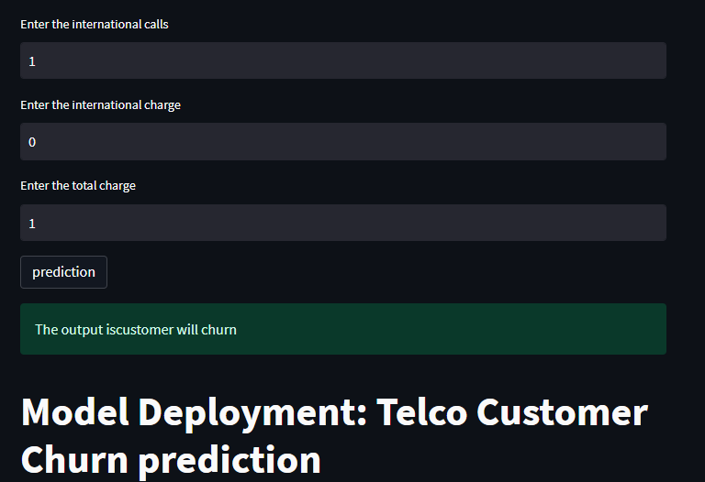
We get our link- https://prajaktasapkal-telecommunicationchurn-temp111-0ff072.streamlit.app/
This link can be used globally i.e on any system.
From this image we can see that or deployment has been done successfully.

Slide 17
RECCOMENDATIONS:
Improve network quality.
Improving customer service is, of course, at the top of the priority for tackling this issue.
Building customer loyalty through relevant experiences and specialized service is another strategy to reduce customer churn.
Some firms survey customers who have already churned to understand their reasons for leaving in order to adopt a proactive approach to avoiding future customer churn.

Slide 18
Thank you.

